Slide 1
Glaciology EESCGU4220
Practical 1: Data analysis and solving equations in python
1. Download SIR_density.csv from canvas
2. Put in a folder you want to work in (call it something like “P1”)
3. Open the terminal at that folder and start jupyterlab.
4. Start a new jupyter notebook.

Slide 2
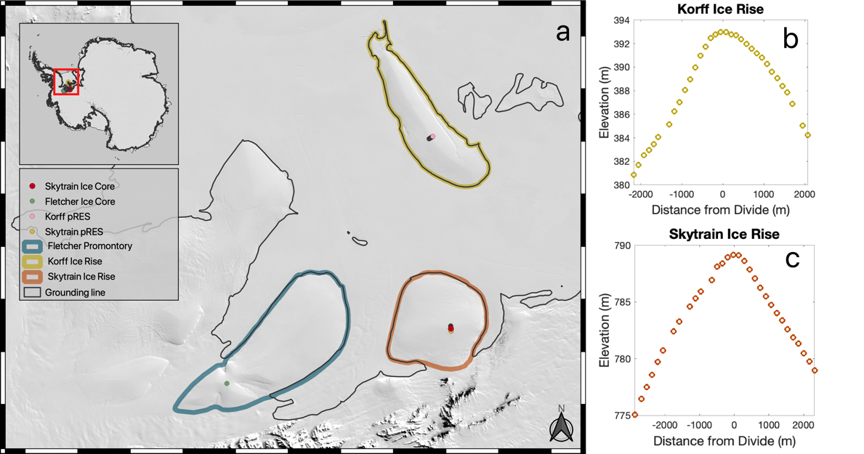
Skytrain Ice Rise, Antarctica
Case and Kingslake, in review

Slide 3
(actually a different field site, but the same people with the same equipment)

Slide 4
(actually a different field site, but the same people with the same equipment)

Slide 6
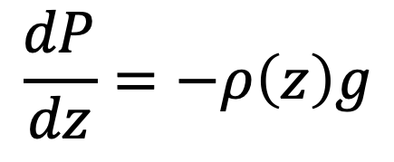
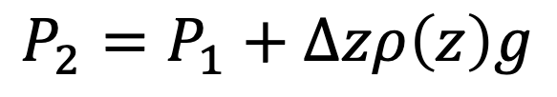



Discretization and numerical integration
Integrating the overburden pressure equation
$$P\left(0\right)=0$$
$$\frac{dP}{dz}=−ρ\left(z\right)g$$
z_{s}
z
$$ρ\left(z\right)$$
$$P_{2}=P_{1}+Δzρ\left(z\right)g$$
$$P\left(z\right)= ?$$
Notes:
To board

Slide 7
Getting started
1. Download SIR_density.csv from canvas
2. Put in a folder you want to work in (call it something like “P1”)
3. Open the terminal at that folder and start jupyterlab.
4. Start a new jupyter notebook.
SIR_density.csv has two columns, the first one is depth from the surface in meters. The second is the density in kg m⁻³.

Slide 8
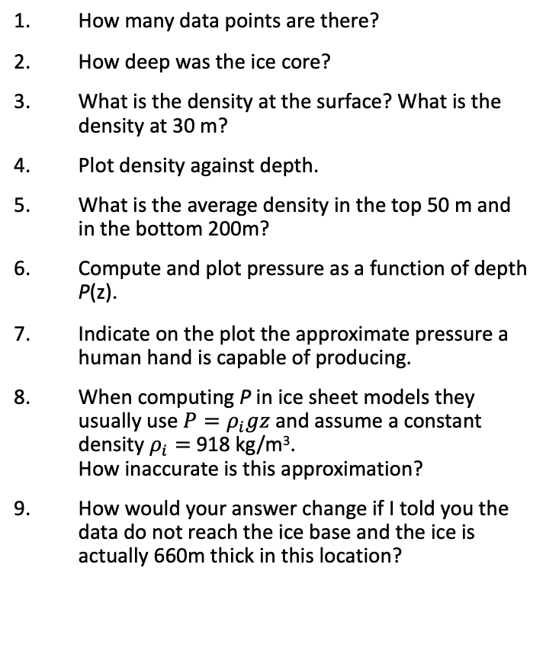
Write a python notebook to answer these questions/do these tasks
numpy functions and methods I used:
loadtxt
print
shape
interp
<
diff
mean
arange
concatenate
How many data points are there?
How deep was the ice core?
What is the density at the surface? What is the density at 30 m?
Plot density against depth.
What is the average density in the top 50 m and in the bottom 200m?
Compute and plot pressure as a function of depth P(z).
Indicate on the plot the approximate pressure a human hand is capable of producing.
When computing P in ice sheet models they usually use ${P=ρ}_{i}gz$ and assume a constant density $ρ_{i}=$ 918 kg/m³. How inaccurate is this approximation?
How would your answer change if I told you the data do not reach the ice base and the ice is actually 660m thick in this location?
matplotlib functions and methods I used:
Plot
ylabel
Xlabel
Ylim
legend
Notes:
Helen Sharman was the first British astronaut and the first woman to visit the Mir space station. They launched on 18 May 1991 from the Baikonur cosmodrome in the Soviet republic of Kazakhstan

